Slide 1
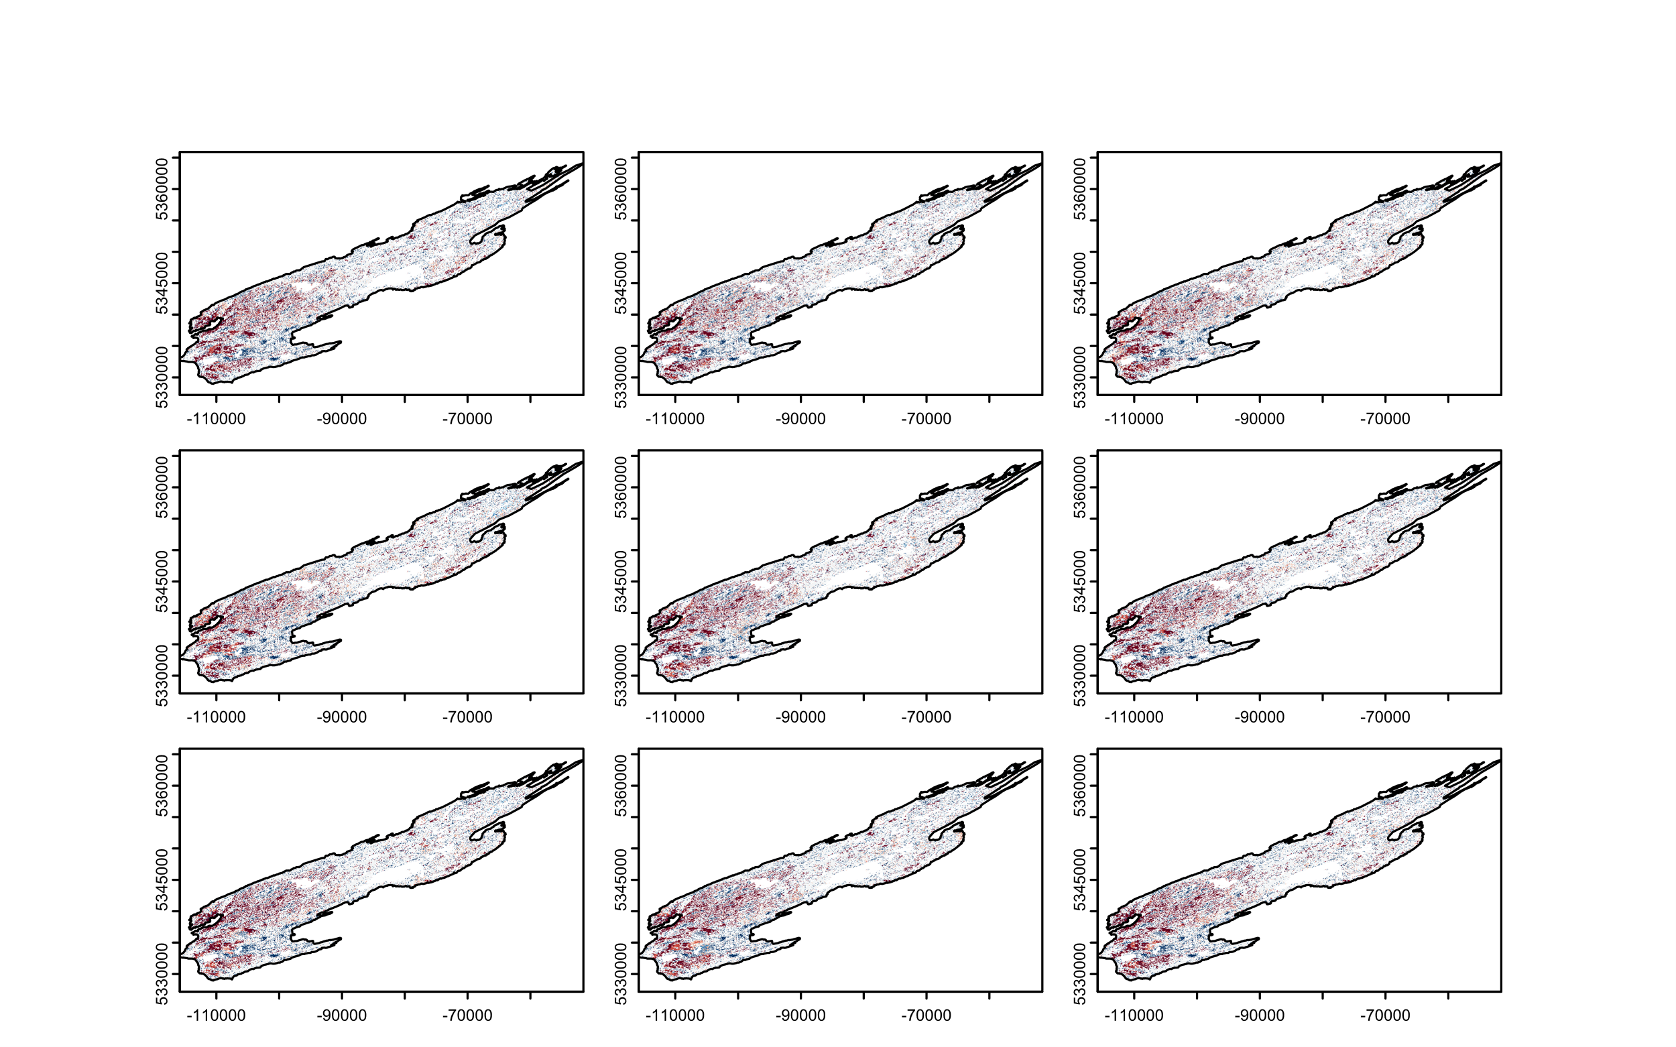
Climate
Low
Hot/Dry
Warm
Hot/Wet
Predation rate
Medium
Gain
Loss
High

